Slide 1
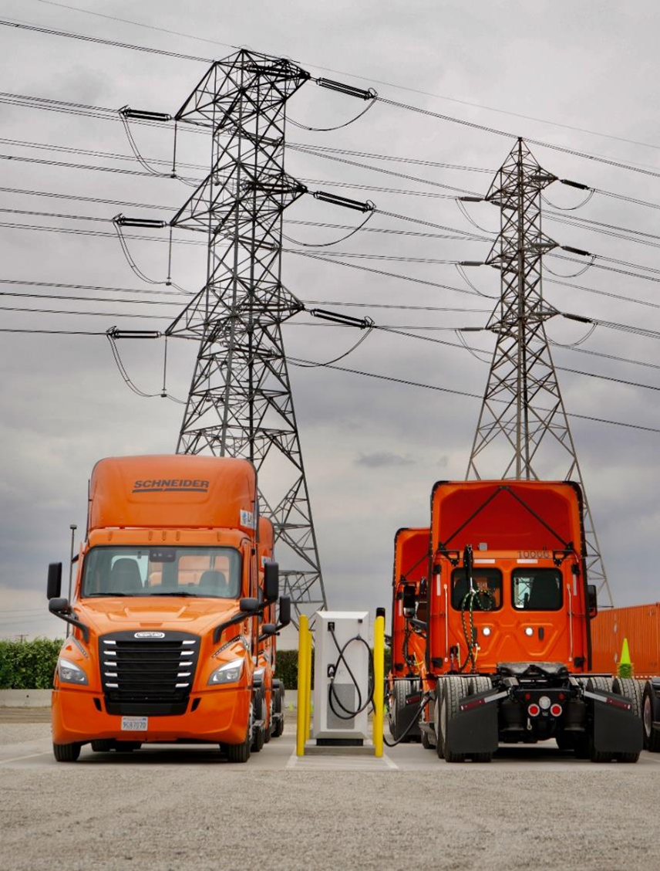



10 Real World EV Truck Depot Case Studies
March 2024
Dave Schaller
Industry Engagement Director

Slide 2




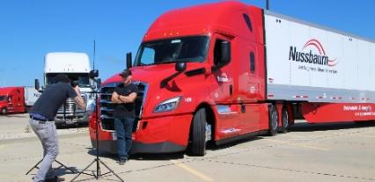
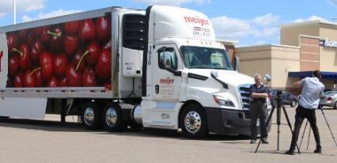

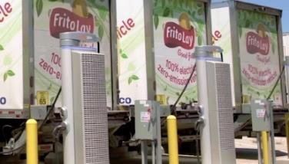

Run on Less - “Best of the Best”
2017
2019
2021
2023
Long Haul
7 Fleets
10.1 MPG
Regional Haul
10 Fleets
8.3 MPG
All BEVs
13 Fleets
EV Truck Pilots
BEV Depots
10 Depots
Infrastructure
2

Slide 3
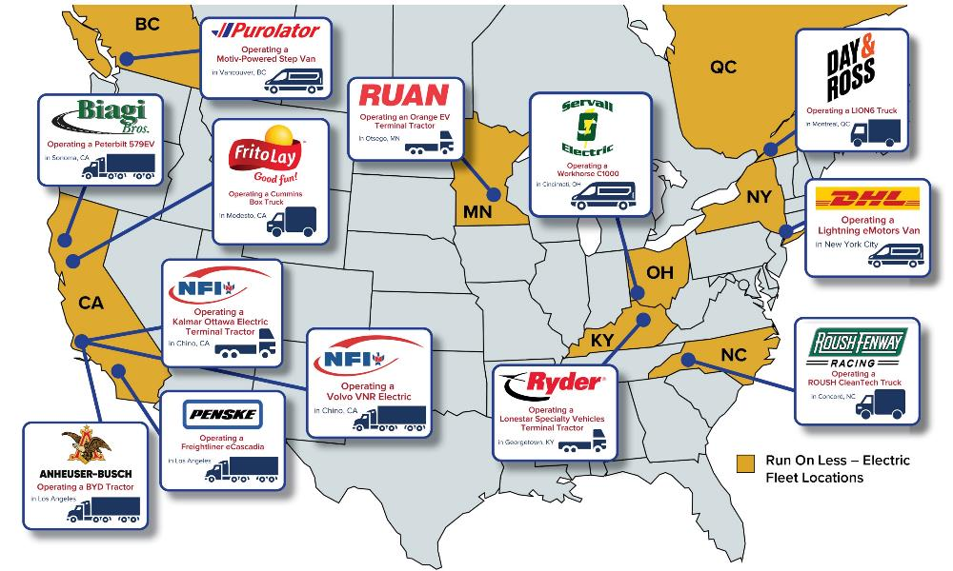


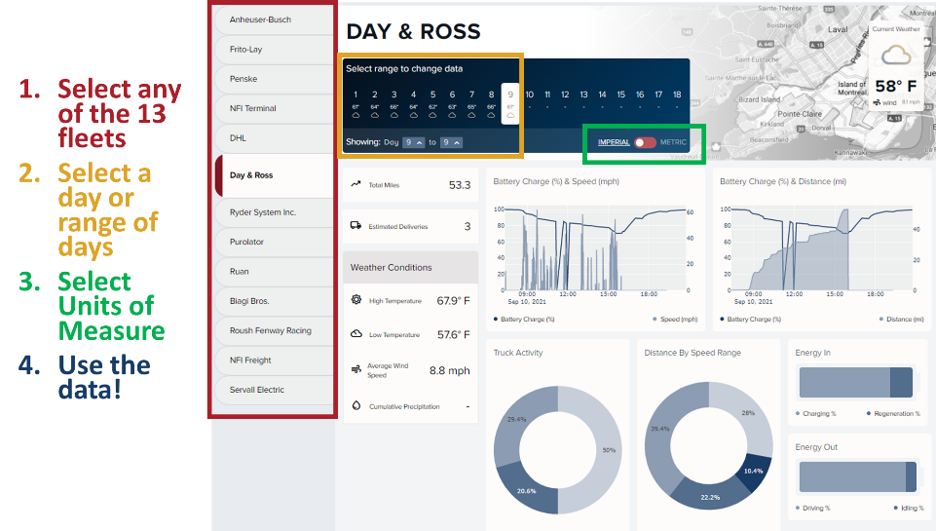
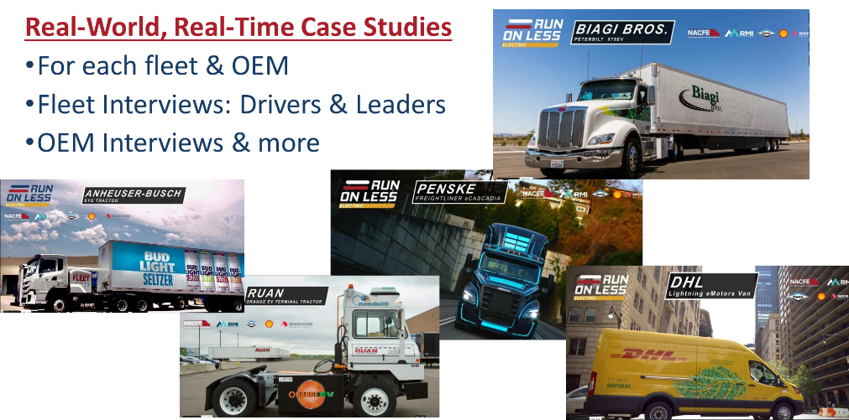
2021
Link

Slide 4
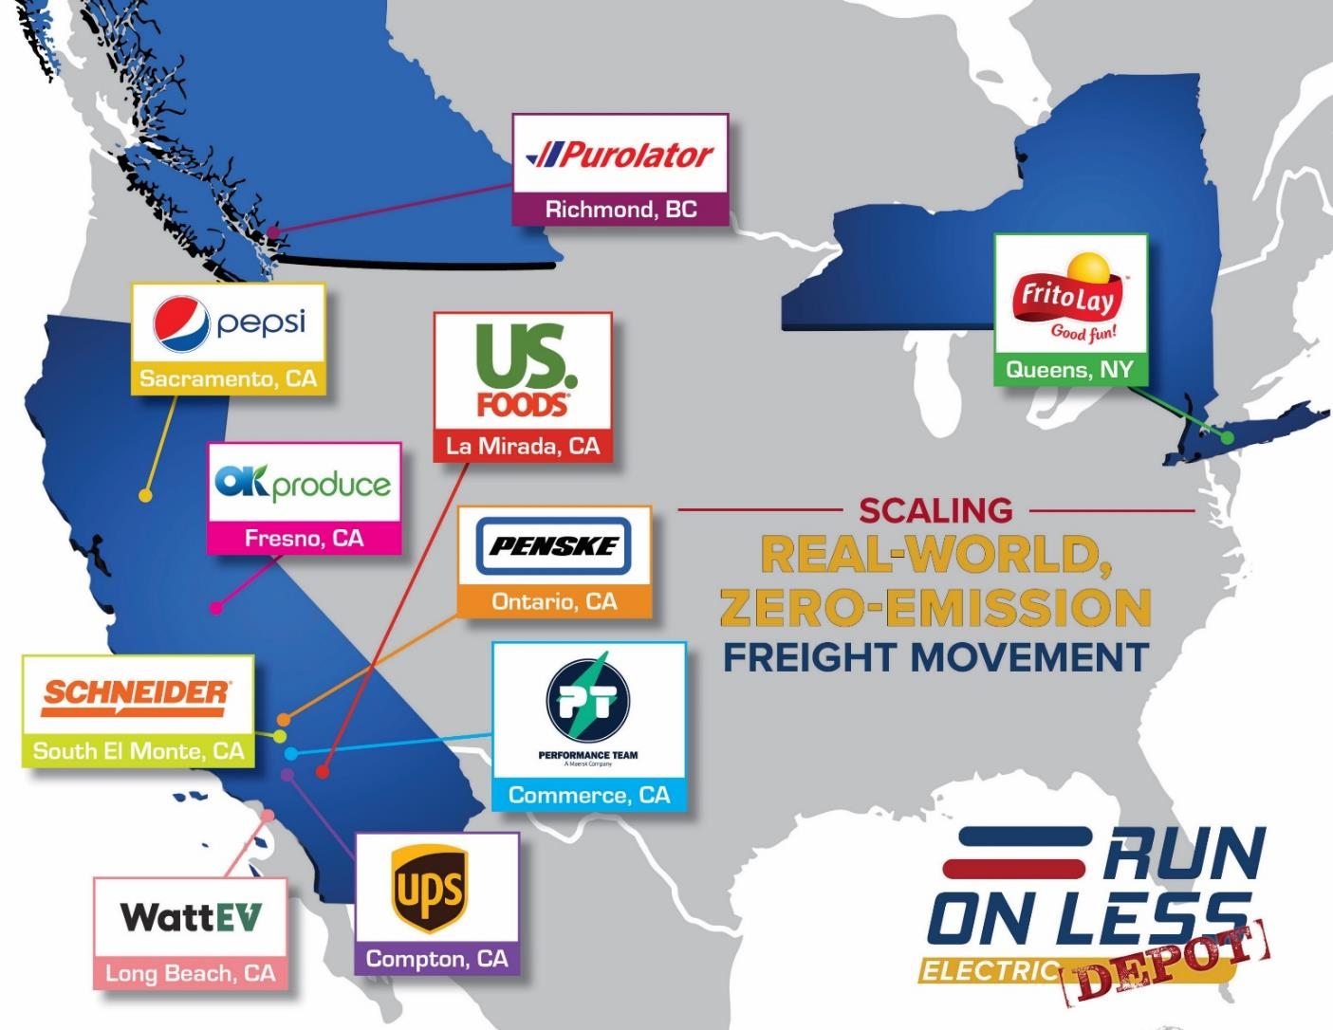
Run on Less - Electric DEPOT 2023
10 fleet locations
Each has at least
15 electric trucks
Many had more
Fleet videos
Telematics data
All information at:
RunOnLess.com
Notes:
Together these fleets have about 300 electric trucks
2021 – 6900 electric miles
2023 – 446,831 electric miles
65X as many miles, so much more data.

Slide 5
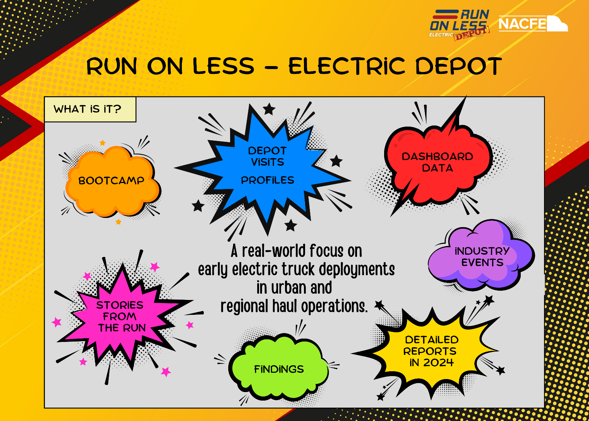

Slide 6






Executive Level
All Videos, Data & Reports are FREE
Event Level
Title Level
Supporter Level

Slide 7
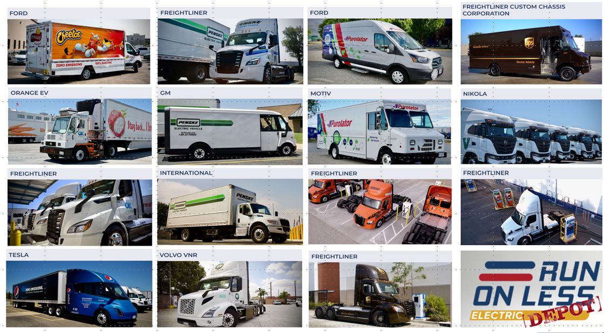
Run on Less Electric DEPOT BEVs

Slide 8
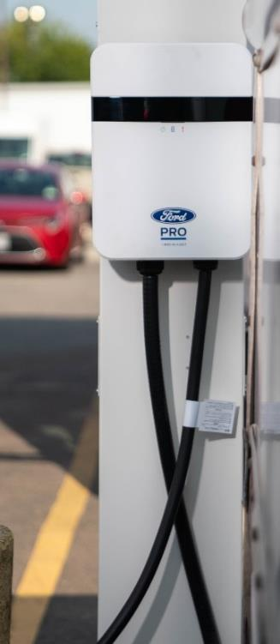
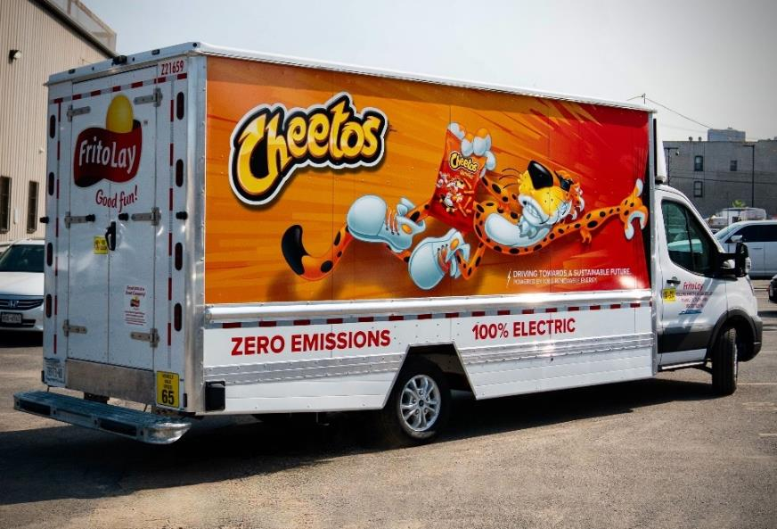
Complete Revitalization: Trucks & Facility in < 1 Year
Frito Lay: New York City/Queens NY
Ford E-Transit Class 2b van
6 Ford Pro chargers
Prologis owned & managed site
Diminishing load routes of snacks in NYC
Con Edison
Notes:
66 trucks total
Level 2 every 5 days

Slide 9
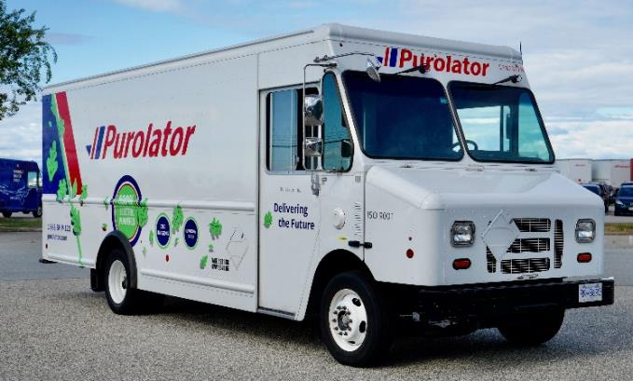
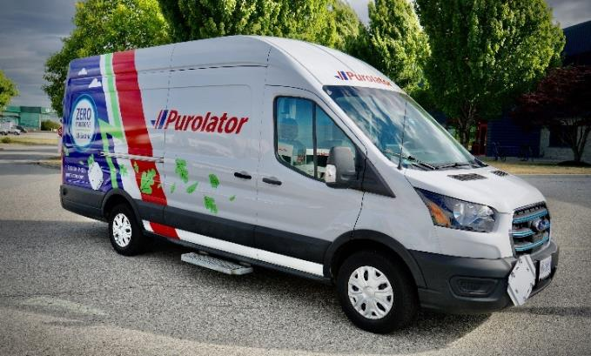
Testing Several Different OEMs
Purolator: Richmond BC
Motiv EPIC Class 6 step van
Ford E-Transit Class 2 van
Other models on order
15 Overhead Level 2 Chargers
Diminishing load package delivery
BC Hydro
Notes:
Pull down allow them to charge any vehicle

Slide 10
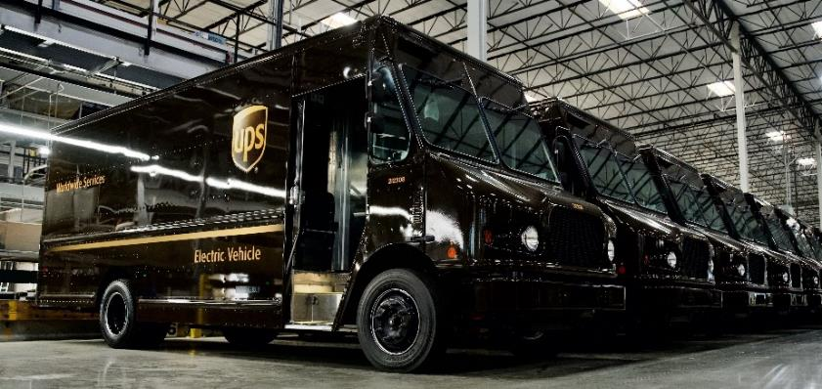
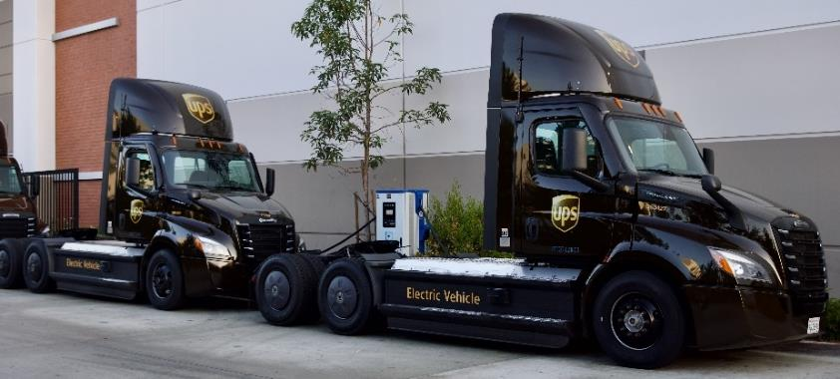
Last Mile inside & Middle Mile outside: 1 CMS
UPS: Compton CA
15 FCCC MT50e Package Cars: DC 30kW (15) delivering packages
10 Freightliner eCascadias: DC 120kW (1 now & 3 soon) Inter-location movements
InCharge charge management system
AHJs delayed external 3 charger install, so single temporary system in place
Southern California Edison

Slide 11
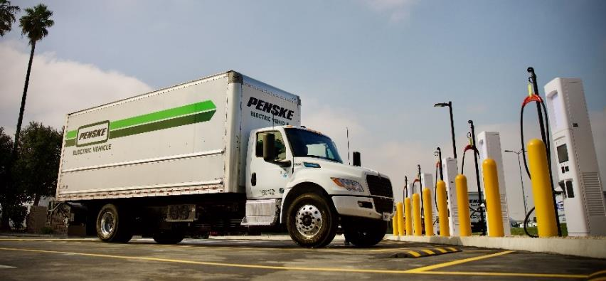
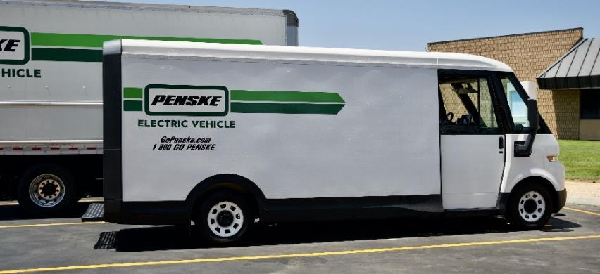
Multiple OEMs & Chargers: INTEROPERABILITY!
Penske: Ontario CA
Ford E-Transit
GM BrightDrop ZEVO 600
Navistar eMVs
Freightliner eCascadias
Chargers:
  6 – Level 2
  2 – Portable 50kW
  8 – Stationary 150kW
On-site Battery Storage: 800 kWh
Southern California Edison
Notes:
On site battery storage allows them to avoid high peaks – 40% savings

Slide 12
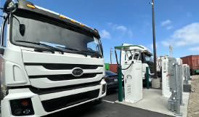
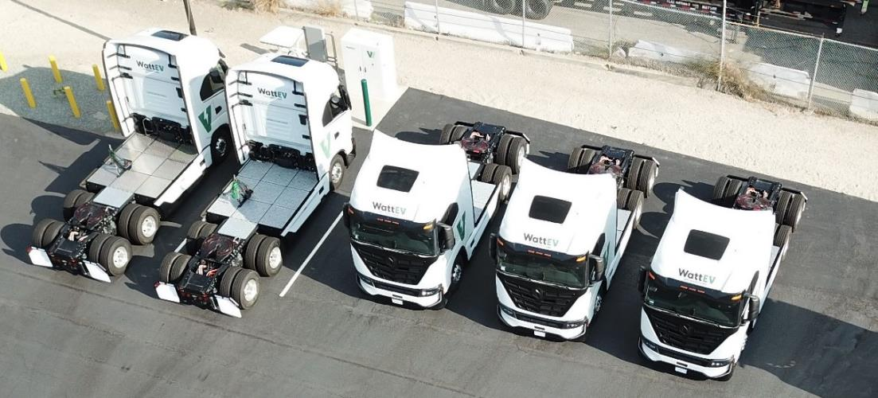
Charging Hub with Truck as a Service (& CaaS)
WattEV: Long Beach CA
Nikola Tre BEV cab-over tractor
BYD 8TT cab-over tractor
Each dispenser charges 2 EVs simultaneously at
180kW or individually at 360kW.
Ampcontrol CMS.
MCS on site!
SoCal Edison with 5 MW

Slide 13
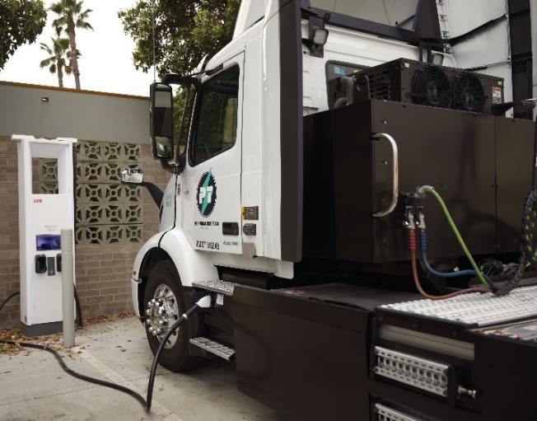
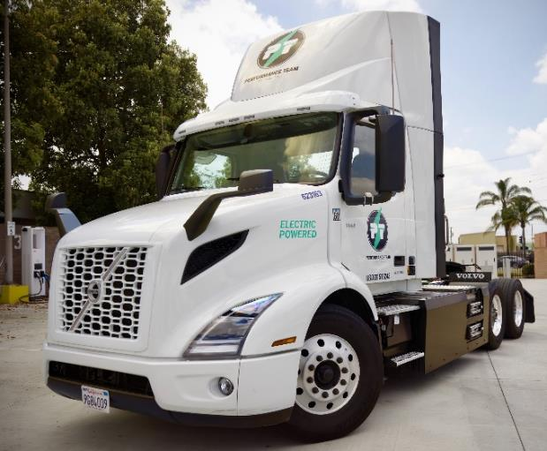
Fast 100% EV Conversion in Short Haul
Performance Team: Commerce CA
16 Gen1 Volvo VNRs (~120 miles and 4 battery packs)
6 Gen2 Volvo VNRs (225 miles and 6 battery packs)
Chargers: 6 x 150 kW modular and 8 x 180 kW standalone
Synop Charge Management System
SoCal Edison

Slide 14
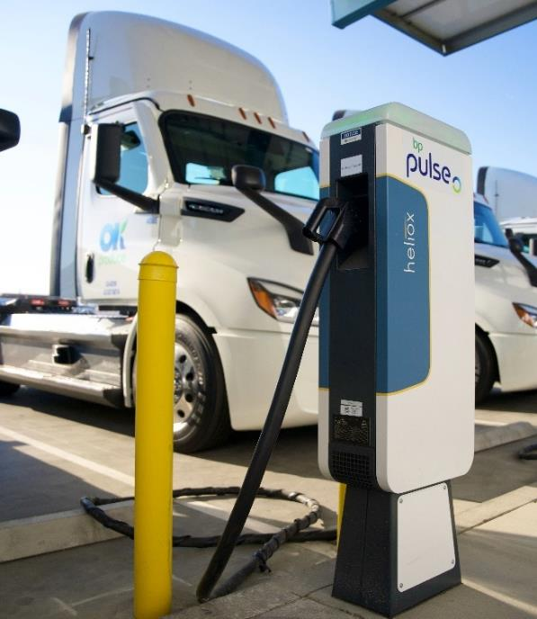
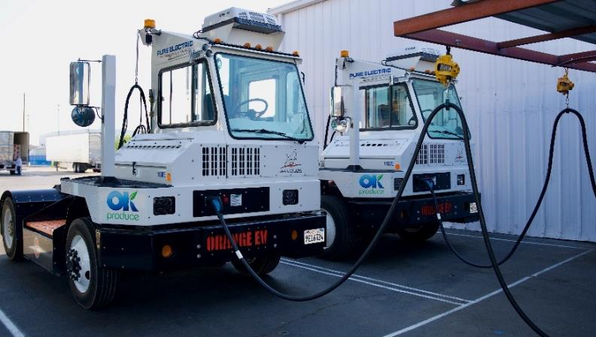
Perishable Fruits and Vegetables: Uptime Paramount
OK Produce: Fresno CA
Aggressive CEO due to air quality concerns
17 Freightliner eCascadias: DC 180 kW
3 Orange EV terminal tractors: AC 22 kW
4 MW Solar & 150 kWh battery storage
bp pulse Charge Management
Pacific Gas & Electric

Slide 15
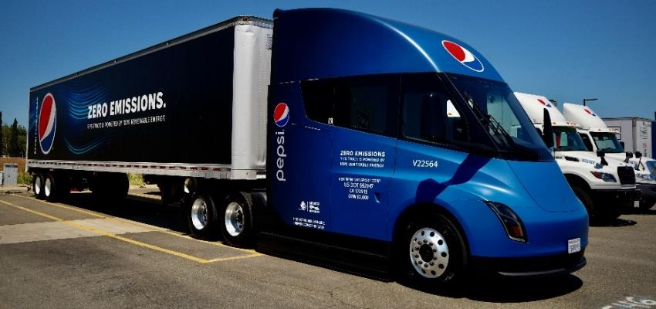
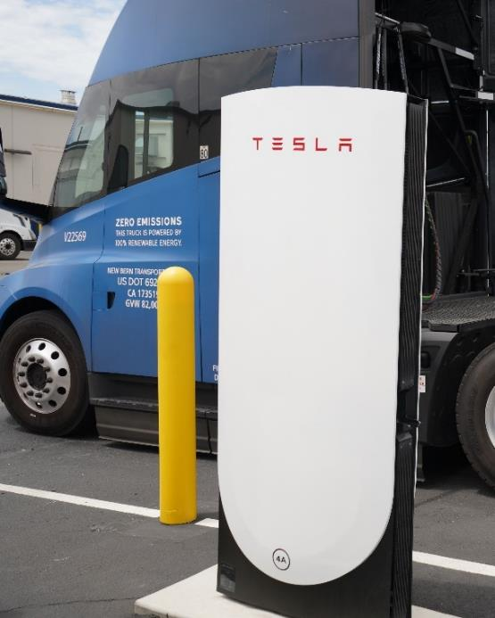
Long Haul & City Delivery with Tesla Semis
Pepsi: Sacramento CA
21 Teslas (3 LH & 18 City)
LH Beverages: 250-450 miles/day
City Beverages: < 75 miles/day
4 Tesla 750 kW chargers
Sacramento Municipal Utility District

Slide 16
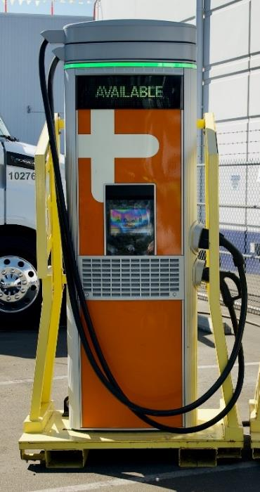
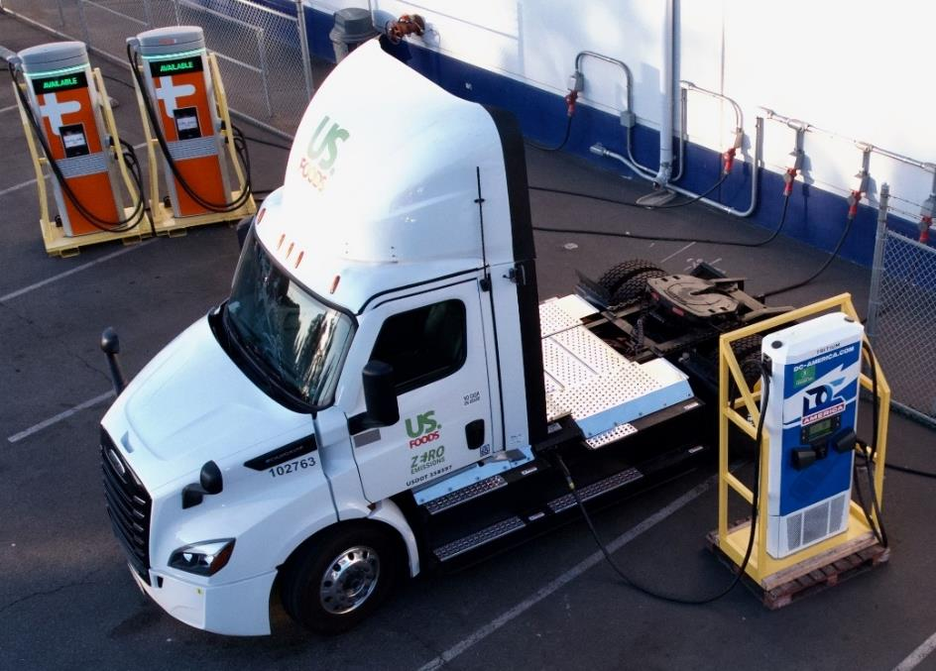
Portable/Temporary Infrastructure Can Be First
US Foods: LaMirada CA
30 Freightliner eCascadias = ⁓$9M
Permitting delayed permanent charging, stranding assets
Portable chargers now: Tritium 75kW & ChargePoint 62.5kW
Food & beverage local delivery to hotels, restaurants, etc.
Southern Cal Edison
Notes:
30 eCascadias @$300K each = $9M in stranded assets.

Slide 17
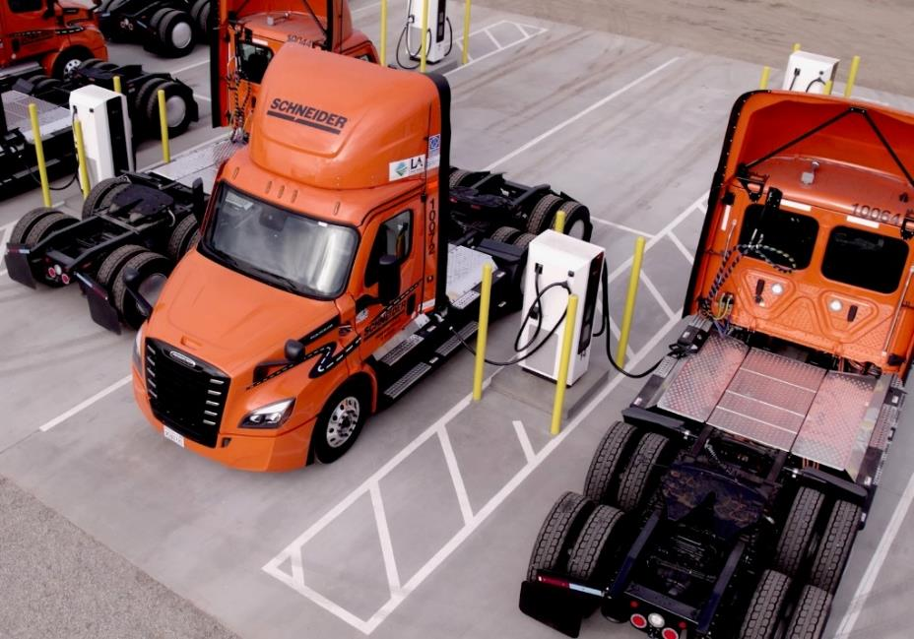
Fast 100% EV Conversion in Slip Seat Operation
Schneider: S El Monte CA
82 Freightliner eCascadias
16 dual cable 350 kW chargers
Multi-shift operations (“slip seat”)
Multiple stop intermodal chassis drop and hook
5 MW from Southern Cal Edison
NACFE estimate: up to 44 MWh per day for the 82 trucks (charging all day long)

Slide 18
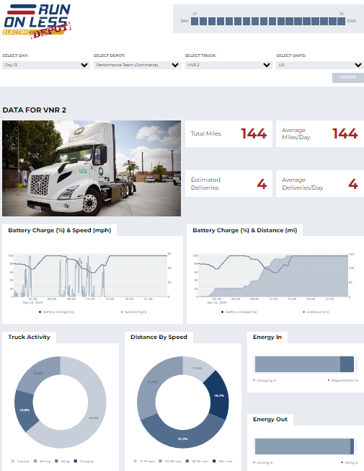
DATA at RunOnLess.com!
Select:
1) Fleet
2) Truck
3) Day
4) Units of Measure
Metrics
August 2023

Slide 19
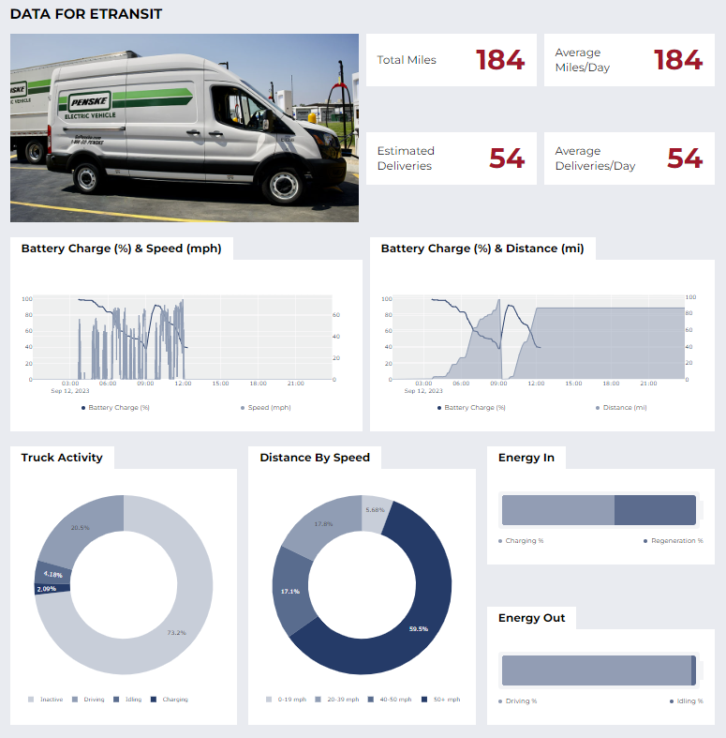
RoL-E DEPOT
Penske Day 2 eTransit
184 miles in a single shift
54 deliveries
Fully charged with another charge middle of the day
A lot of regenerative braking
41% of miles under 50 MPH

Slide 20
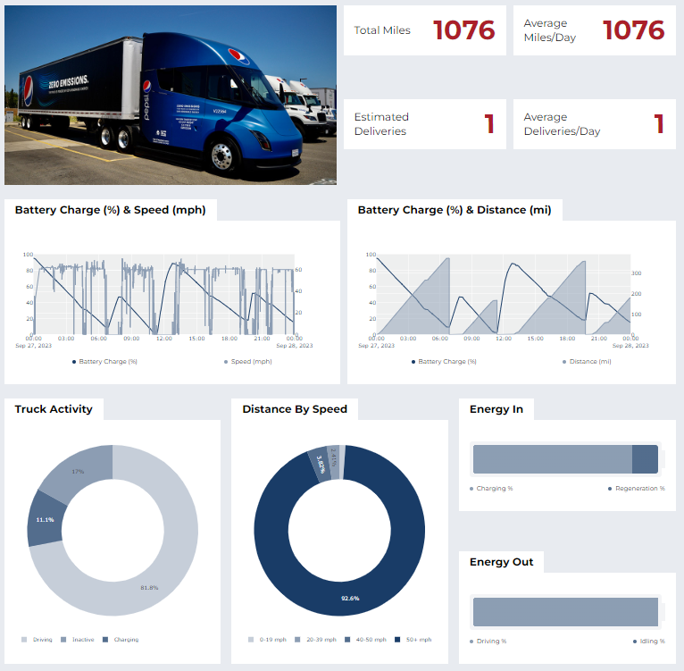
New RH Metrics
Tesla Semi at Pepsi
Sacramento CA depot
1076 miles (1,732 kilometers) in 24 hours
5 deliveries
Three charging sessions
Some regenerative braking
Most of the day above 50 MPH = 80.5 KPH (55 MPH/88.5 KPH speed limit in California)

Slide 21
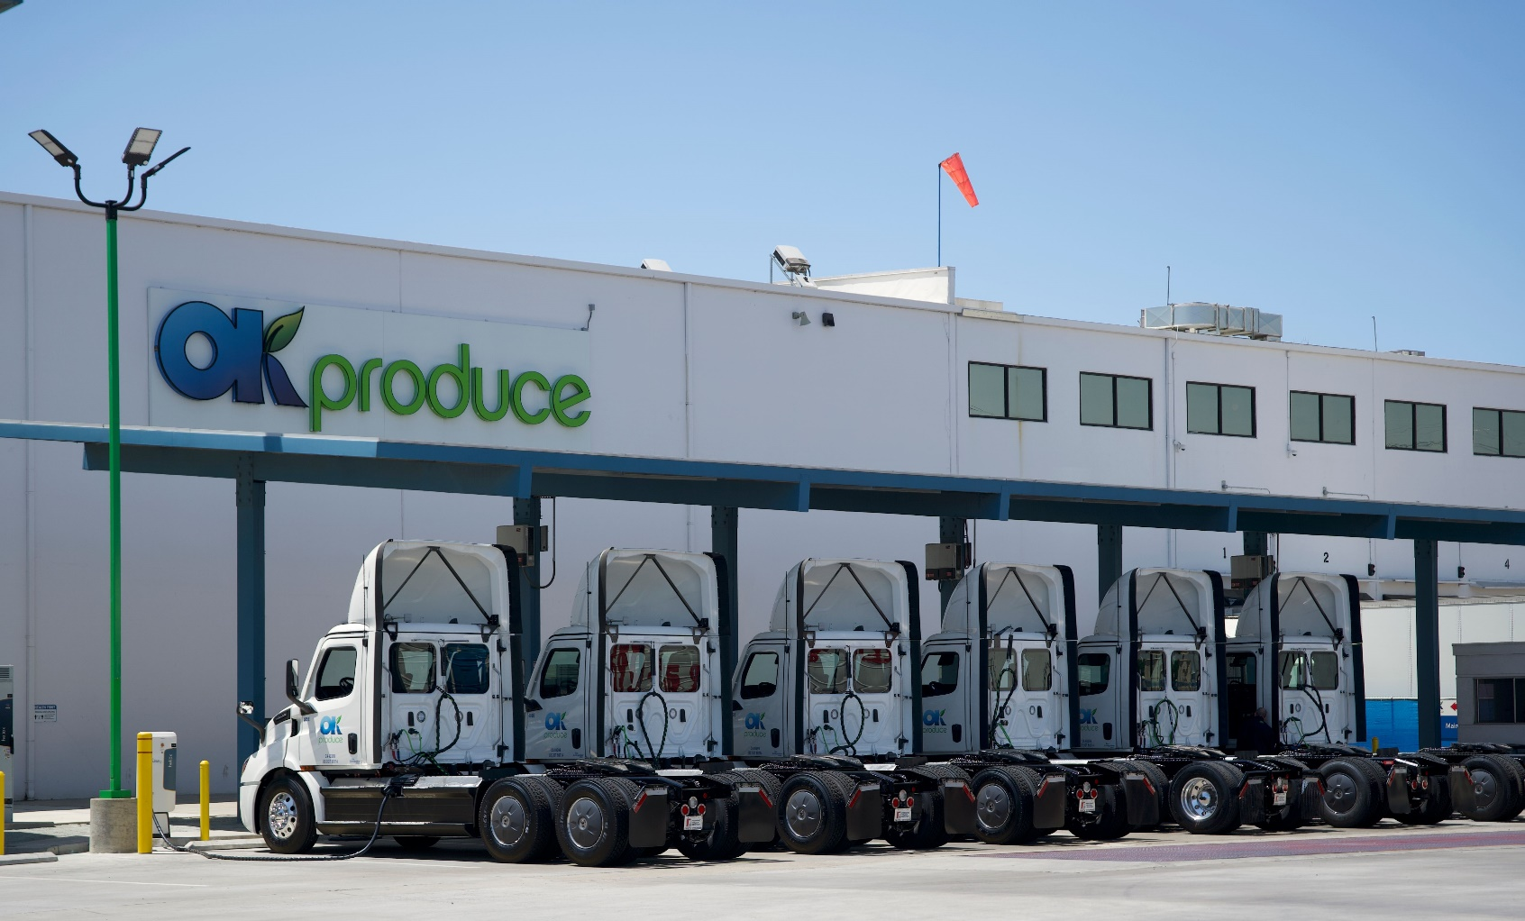

RoL-E DEPOT Next Steps
Data analysis including a data workshop
Additional questions for the fleets/utilities
Writing reports based on data and direct learnings from the 10 depots
Increased presentations and workshops, especially in Canada
21

Slide 22

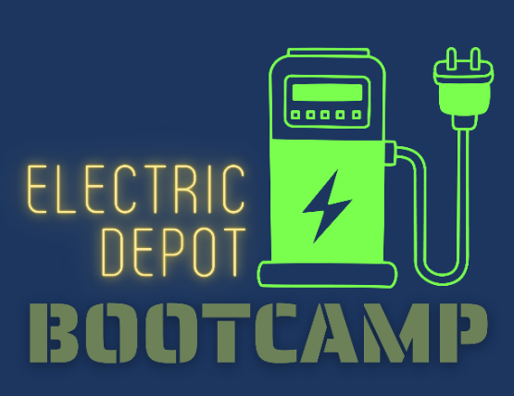
DEPOTS Electric Truck Bootcamp
Best Practices for Utility-Fleet Relationships
Grants and Incentives for the Trucks and Infrastructure
Electric Truck Developments
Faster Charging — Opportunities and Challenges at 350KW and higher
Opportunities to Extend BEV Range (via charging technologies)
Electricity Resiliency and Availability (microgrids, renewable energy…)
Current and Future Regulations for Zero Emission Trucks
Managed Charging to Improve Availability, Cost and Range
Scaling Charging Infrastructure Equipment
Electric Depot Site Planning and Construction
Available at RunOnLess.com – click on Bootcamp

Slide 23
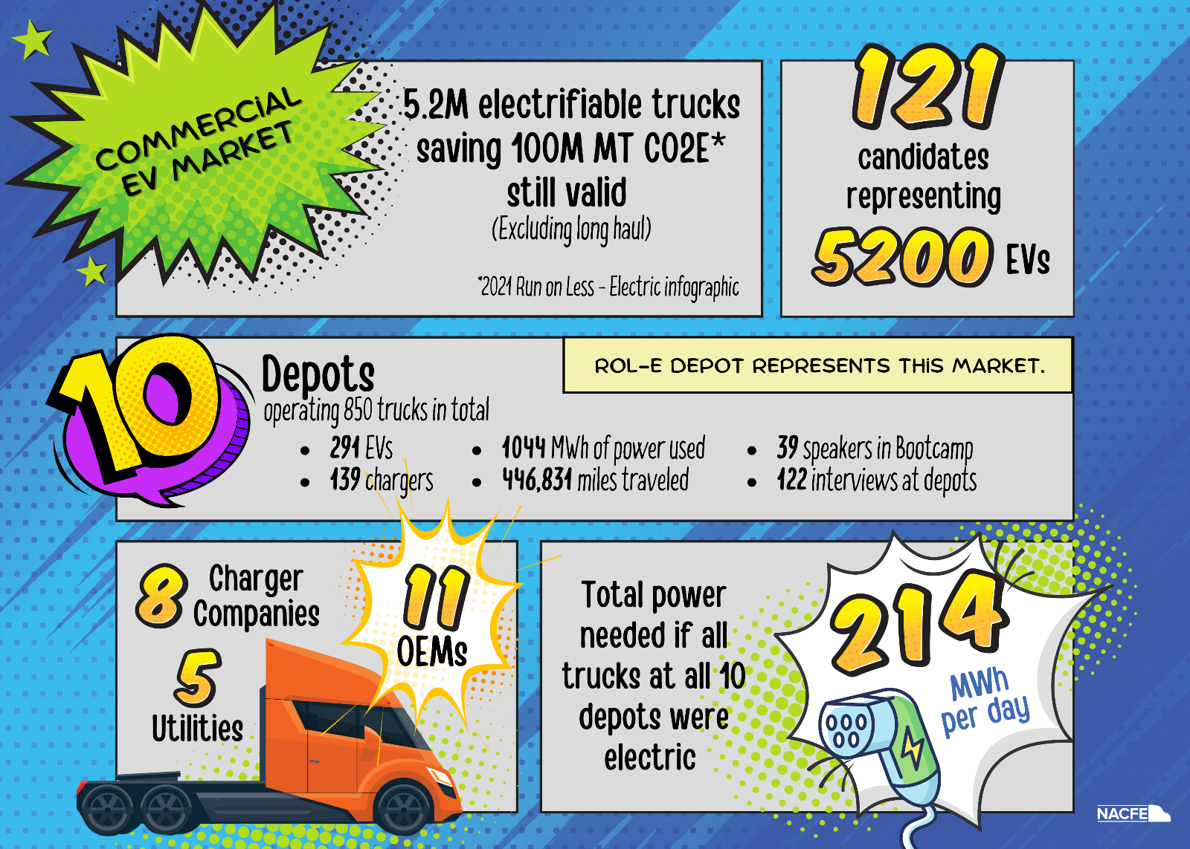

Slide 24
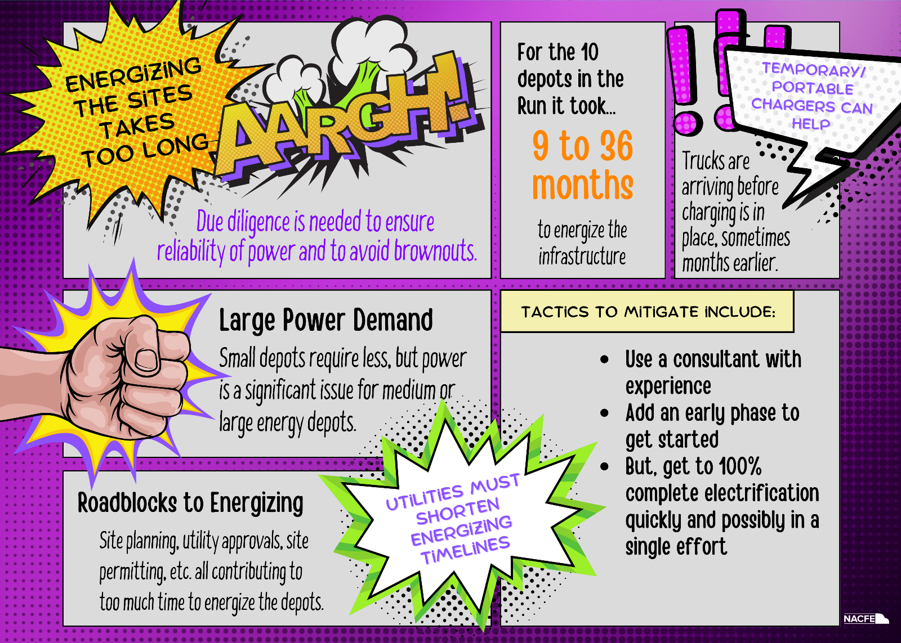

Slide 25
New Playing Field for Electrification
New
Utility Regulatory Commission
Design & Construction (EPC)
Utility
Rate Structures (TOU)
EVSE
Authority(s) Having Jurisdiction
Charge Management System
Fleet
Landlords
OEM
Dealership
Fleet
Existing
Body Builder
Key Suppliers
December 2023

Slide 26
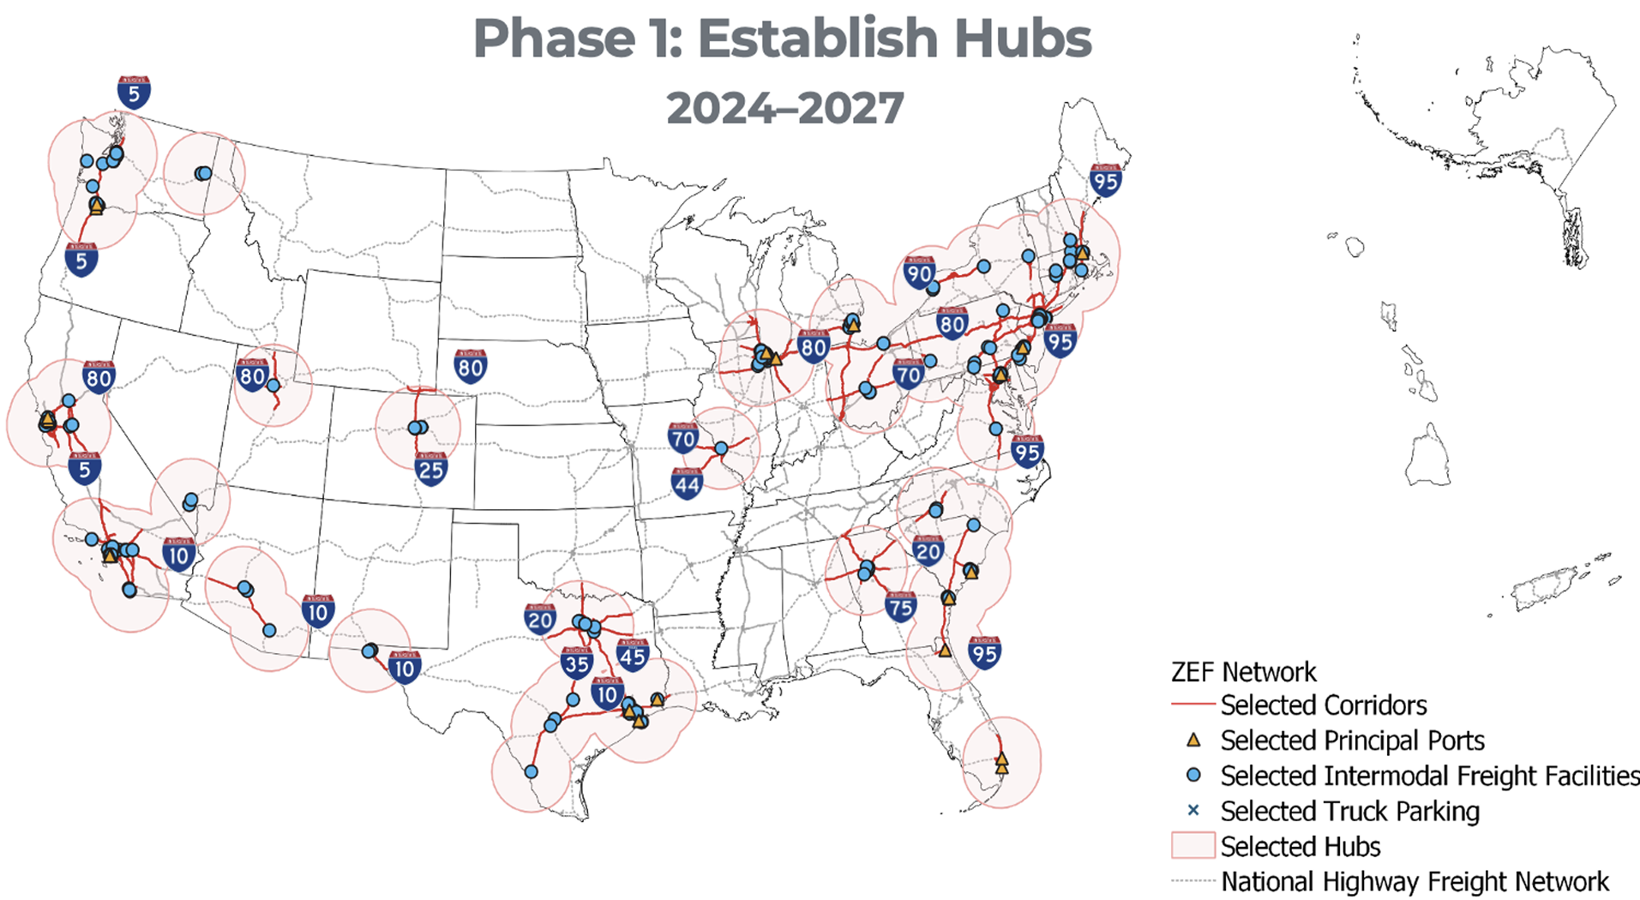
EV Corridor & Proposed Hubs
First of four phases
Start where initial EV trucks are operating (typically high population density areas)
Near ports and intermodal facilities
Supports hub & spoke ops
Environmental Justice 40 areas
Grows the range of depot based trucks in the area
zef-corridor-strategy.pdf (driveelectric.gov)
26

Slide 27
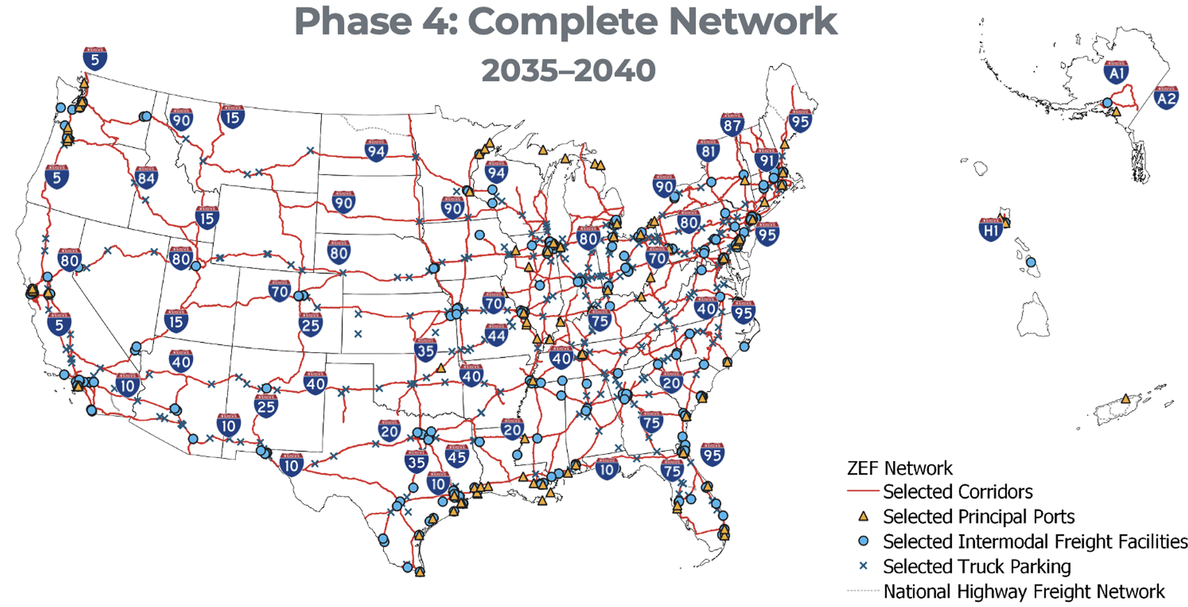
EV Corridor Phase 4
zef-corridor-strategy.pdf (driveelectric.gov)
27

Slide 28

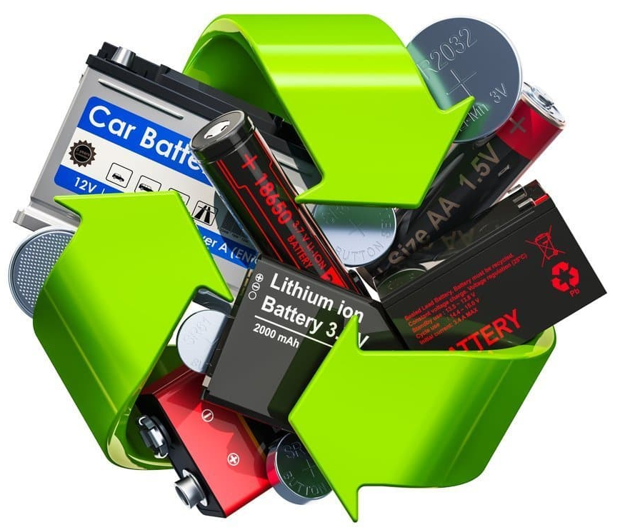
Battery Second Life & Recycling
Recycling businesses growing:
Redwood Materials
Li-Cycle
Cirba Solutions
ReElement Technologies
Secondary Uses for EV Batteries:
Can be used as Battery Energy Storage Systems (BESS) for chargers
First generation eCascadia batteries to be integrated into the “Electric Island” charging complex
Eventually a circular supply chain: https://rmi.org/battery-circular-economy-initiative/
28

Slide 29
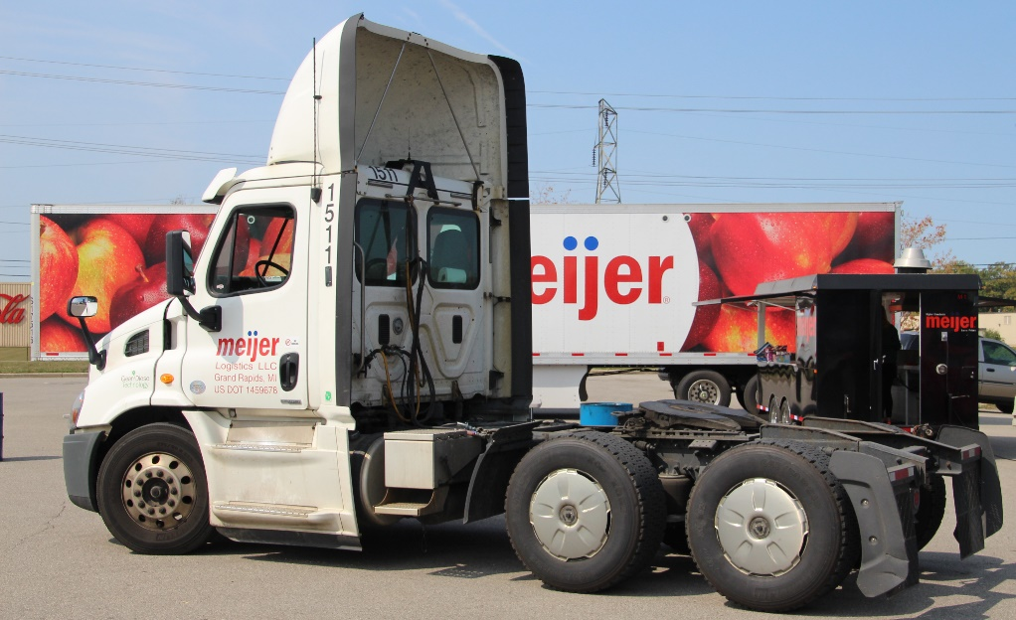
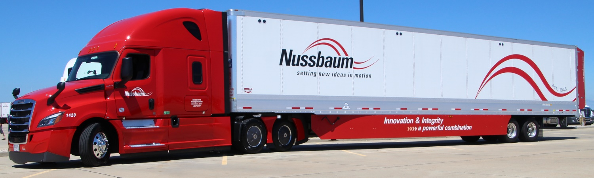
Charging: Day Cabs vs Sleepers
Sleeper located behind driver’s seat
Day Cab
Sleeper
Short & Regional Haul
Long Haul
About 40% of all tractors built every year are day cabs. They are DEPOT based and home every day.
Some day cabs do long haul (can stay at hotels at night)
Numerous sleepers do short/regional haul
  Old sleeper trucks doing drayage work
  Some fleets buy all/mostly sleepers so they can move from one contract to another
29

Slide 30
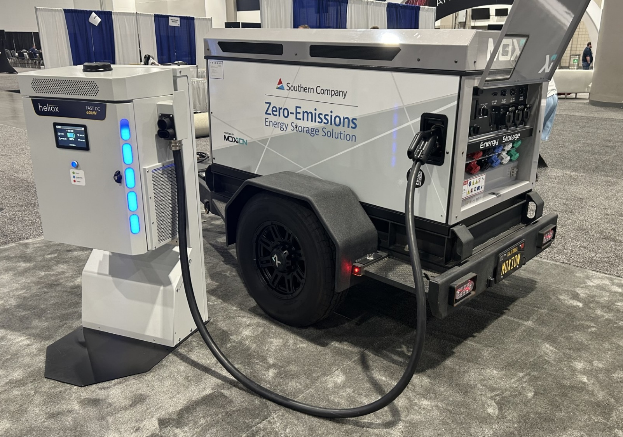
Temporary Charging Options
Numerous options
Pioneer eMobility
Moxon Power
Xos Hub
Nikola
Voltstack
Momentum Group
Setec Power
Can be powered by battery storage, solar panels or a generator running on RNG, CNG, LP, RD, diesel…
30

Slide 31
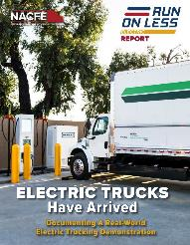

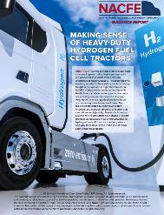
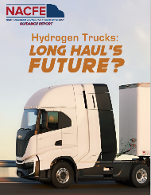

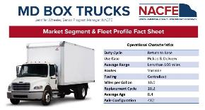
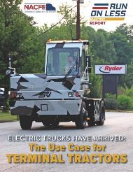
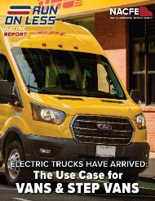
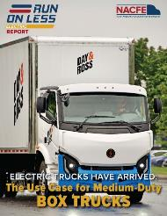
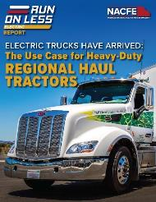



Key NACFE Reports on ZEV Trucks
4 Market Segment Fact Sheets
Jan 2022
Review Of Demonstration:
Electric Trucks Have Arrived
Feb 2023
The Messy Middle:
A Time For Action
Dec 2020
Making Sense of Heavy Duty Hydrogen Fuel Cell Tractors
Apr 2023
Hydrogen Trucks: Long-Hauls Future?
Dec 2023
Intermodal & Drayage
Mar 2022
The Use Case For
Terminal Tractors
Apr 2022
The Use Case For
Vans & Step Vans
Jun 2022
The Use Case For
Medium Duty Box Trucks
May 2022
The Use Case For
Regional Haul Tractors
Apr 2019
More Regional Haul: An Opportunity for Trucking?
Jan 2020
Defining Production
Dec 2019
Viable Class 7/8 Electric, Hybrid and Alternative Fuel Tractors

Slide 32











CCS1
CCS2
NACS/Tesla
MCS or CharIN
NACFE.org
Let’s Stay Connected…
…and Charged Up!
NACFE (& Spanish: NACFE LATAM)
RunOnLess.com
NACFE
Dave Schaller
David.Schaller@NACFE.org
260-602-5713
@NACFE_Freight & @RunOnLess
NACFE

Slide 33

THANK YOU

Slide 34

Charging Forward GR
Conclusions:
Electric trucks and chargers must work together
Your utility is a key partner
Use and design greatly affect charging cost
The transition requires staff and attention
Consider other charging business models
Other key considerations
  Grants & incentives
  Microgrids
  Landlords
  Reliability and interoperability of chargers
  And more…
https://nacfe.org/research/electric-trucks/#charging-infrastructure

Slide 35
Market Segmentation & ZEV Reports
Run on Less – Electric DEPOT
RoL-E Vans & Step Vans EV Use Case – Apr ‘22
MD Electric Trucks TCO – Oct ’18
RoL-E MD Box Trucks EV Use Case – Jun ‘22
ZEV for Drayage Report – Coming Jan ’24
More Reg Haul – An Opportunity – Apr ’19
Viable Class 7/8 Electric Trucks – Dec ‘19
RoL-E Report EVs Have Arrived – Jan ‘22
RoL-E Terminal Tractors Use Case – Mar ’22
RoL-E HD Tractors Use Case – May ’22
Charging Forward (Infrastructure) – Jun ‘23
Elec Trucks Where They Make Sense – May ’18
Hydrogen Trucks LH’s Future – Apr ‘23
35

Slide 36



EV Truck Deployments (Jan ‘24)
Deployed as of June 2023
17,734 Zero Emission Trucks Deployed 2b-8
13% are in California (2022 = 46% and 2021=60%)
Source: Calstart January 2024
Zeroing in on Zero-Emission Trucks: The State of the U.S. Market (calstart.org)
36

Slide 37


Slide 38


Slide 39


Slide 40
North American Council for Freight Efficiency
TIRE PRESSURE
AERODYNAMIC
SUSTAINABILITY
AUTONOMY
EFFICIENCY
ELECTRIFICATION
HYDROGEN
CONFIDENCE
MPG
GUIDING
BENCHMARKS
UNBIASED
IDLE REDUCTION
FUEL AGNOSTIC
NON-PROFIT

Slide 41
Terminal Tractors
22 Trucks Being Monitored
MD Box Trucks
Orange EV (1)
Navistar eMV (1)
Vans & Step Vans
Class 8 Tractors
FCCC MT50e (1)
Ford E-Transit (4)
Motiv EPIC (1)
Freightliner eCascadia (7)
Volvo VNR (2)
Tesla Semi (3)
Nikola Tre BEV (1)
BYD 8TT (1)
Bold = New OEM for 2023 RoL-E DEPOT

Slide 42







Power & Trucking Industries

Slide 43






Regardless of their initial feelings, drivers LOVE them once they have driven one.
Drivers Love Electric Trucks

Slide 44


Annual Fleet Fuel Study
New Release: December 2022
Adoption takes time
Hard things take longer
AFFS link

Slide 45
Some of these are counter to common assumptions:
Interesting Observations
Some trucks don’t get charged every day, and others get charged multiple times per day
Some depots have a one-to-one relationship of trucks and chargers, but many have fewer chargers than trucks
Some trucks get high regenerative braking energy back and some barely get any. (loads, routes, settings, drivers, training…)
There is a growing variety of solutions to charge trucks without full permanent infrastructure.
Fleets finding ways to make range limited EVs work for them. Multiple charges per shift.

Slide 46

Invitation to the White House
Shared Learnings from DEPOTS
NACFE & RMI where invited to bring DEPOT fleets and other early electrifying fleets to DC
Attended by the Departments of Transportation, Energy, Labor and others
Shared both benefits and challenges
5 hours of educational focus: direct dialogue of real world experiences
Meeting held November 9, 2023

Slide 47





Research and publish reports similar to 2021:
RoL – Electric DEPOT Next Steps
Release a data set and infographics for the demonstration
Report on battery electric trucks
Report on EVSE
Report on infrastructure
2021 Reports

Slide 48



DEPOT Filming
122 Interviews!!
10 Fleet Profile Videos
48

Slide 49


Complexity In Both Industries
Truck Fleets
Utilities
Trucks
Tractors
Trailers
Drivers:
Company
Independent Contractors
Owner-Operators
Services:
Generation
Transmission
Distribution
Ownership:
Independent
Municipal
Cooperatives
Vehicles:
Owned
Leased
Facilities:
Owned
Leased
Dozens of different applications
Rate Structures:
Time Of Use
Demand Charges
Regulated
& Unregulated
Fuels: diesel, biodiesel, CNG, LNG, LP, DME, electric, hydrogen, renewable diesel, RNG, RLP, hybrids & more
Fuels: NG, coal, hydroelectric, solar, wind, nuclear, and more
“If you’ve seen
one ___,
you have only
seen one.”

Slide 50

RoL–E Reports
January 12, 2022
Review Of Complete
Demonstration:
Electric Trucks Have Arrived
March 6, 2022
The Use Case For
TERMINAL TRACTORS
April 11, 2022
The Use Case For
VANS & STEP VANS
May 5, 2022
The Use Case For
REGIONAL HAUL
TRACTORS
June 28, 2022
The Use Case For
MEDIUM DUTY
BOX TRUCKS
Other NACFE Whitepapers on Truck EVs:
https://nacfe.org/research/electric-trucks/

Slide 51
Adoption Timing: 5 Year Trade Cycle
Assumptions:
5 Years = 20% of fleet replaced yearly
Years 1 & 2 validating a few trucks
Year 3 = Half of the annual order
Year 4 = Full adoption in order

Slide 52
Adoption Timing: 12 Year Life Cycle
Assumptions:
Truck considered “dead” at 12 years
12 Year Life equates to 8% new trucks every year
Years 1 & 2 validating a few trucks
Year 3 = Half of the annual order
Year 4 = Full adoption in order

Slide 53
RoL-E DEPOT Early Lessons Learned
Small depots are ready for electrification now and large depots are becoming more possible.
Big improvements in trucks and chargers since RoL–Electric in 2021.
Need cost and weight reductions to improve the total cost of ownership.
Range can be extended with multiple charges per shift at the depot and enroute.
It’s still taking too long for power delivery and infrastructure to be installed, which is driving portable charging.
The diversity, passion and capability of the people involved is helping to scale the adoption of electric trucks.
Knowing exactly how a fleet is used (duty cycle in trucking terms) is essential selecting appropriate infrastructure.
Fleets have successfully moved to all-electric while still maintaining their full services

